Slide 1
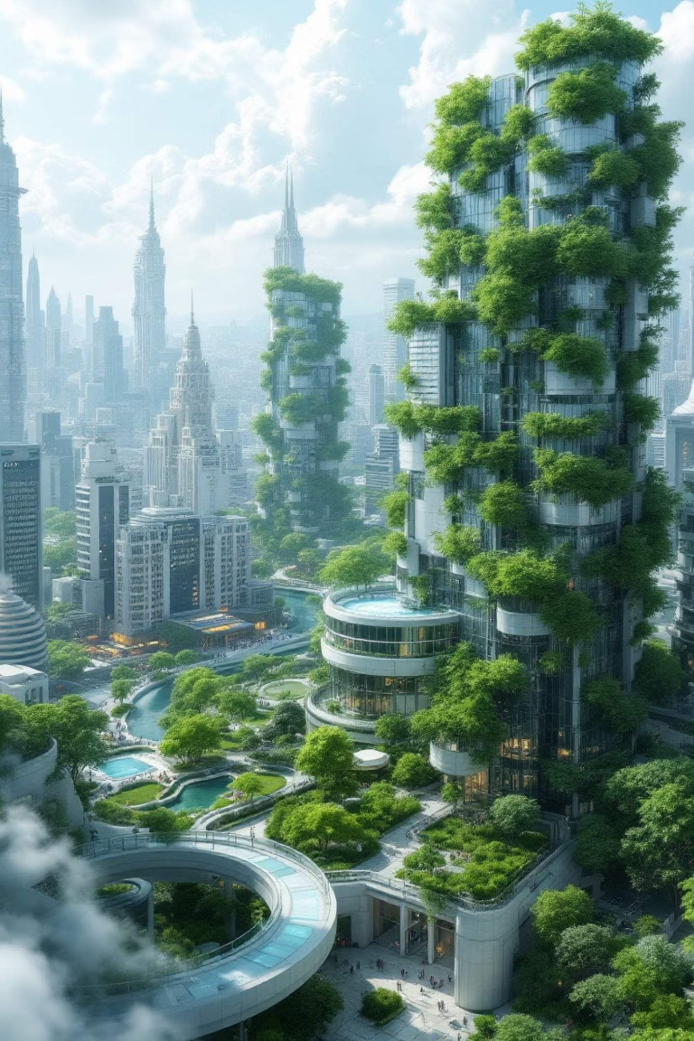
Smart Urban Heat Island Monitor & Advisory System (SUHI-MAS)
Student Name: Sahil Namdev Jadhav
Programme: B.Tech Artificial Intelligence & Data Science
Internship: 1M1B : AI for Sustainability Virtual Internship

Slide 2
Problem Overview: Understanding Urban Heat Islands
What are Urban Heat Islands?
Why a Serious Urban Problem?
Urban Heat Islands (UHIs) are metropolitan areas significantly warmer than their surrounding rural areas. This phenomenon is primarily driven by human activities and the built environment, leading to elevated temperatures particularly at night.
The prevalence of impervious surfaces like concrete and asphalt, coupled with a lack of green spaces and anthropogenic heat sources, traps heat and prevents cooling, exacerbating thermal discomfort for city dwellers.
Impact on Health
Impact on Energy & Environment
Elevated temperatures increase the risk of heat-related illnesses, including heat stroke and exhaustion, disproportionately affecting vulnerable populations such as the elderly, young children, and those with pre-existing medical conditions.
Higher urban temperatures lead to increased demand for air conditioning, straining energy grids and contributing to greater greenhouse gas emissions. Furthermore, UHIs degrade air quality and impact local ecosystems.

Slide 3


Problem Statement & Motivation
How might we use AI to monitor and predict urban heat island intensity and provide real-time localised heat safety advisories?
Empowering Citizens with Advisories
Providing localised, actionable heat safety advisories can significantly reduce public health risks during extreme heat events. This project aims to empower citizens with the information needed to make informed decisions and stay safe.
The Critical Need for Prediction
Accurate prediction of UHI intensity is crucial for proactive urban planning and public health interventions. Traditional methods often lack the granularity and real-time capabilities required for effective mitigation strategies.

Slide 4


Aligning with Sustainable Development Goals
SDG 11: Sustainable Cities and Communities
SDG 13: Climate Action
SUHI-MAS directly supports the development of inclusive, safe, resilient, and sustainable cities by addressing environmental challenges posed by UHIs and improving urban liveability for all residents.
By providing tools to monitor and mitigate the effects of urban heating, the project contributes to combating climate change and its impacts, fostering a more climate-resilient urban environment.
Our project contributes to global sustainability efforts by leveraging AI to build more resilient and informed urban environments.

Slide 5





Proposed Solution: SUHI-MAS Overview
Inputs
AI Processing
Outputs
Real-time weather data (temperature, humidity, wind speed), satellite imagery, urban infrastructure data, and historical climate patterns feed into the system.
Advanced AI models analyse the input data to detect UHI patterns, predict future intensity, and generate contextual insights for heat risk assessment.
Localised heat safety advisories, UHI intensity maps, and actionable recommendations for urban planners and citizens are delivered via a user dashboard.
The Smart Urban Heat Island Monitor & Advisory System (SUHI-MAS) integrates diverse data sources with sophisticated AI to provide timely and targeted heat safety information.

Slide 6

System Architecture
Weather APIs
Preprocessing
AI Heat Model
RAG + LLM Advisory
The architecture is designed for robust data ingestion, intelligent processing, and user-centric information dissemination.
Weather APIs & Simulated Data: Continuous streams of meteorological data combined with synthetic datasets for comprehensive coverage.
Data Preprocessing: Cleansing, normalisation, and feature engineering to prepare diverse data types for AI consumption.
AI Heat Prediction Model: The core analytical engine, leveraging machine learning for accurate UHI forecasting.
RAG + LLM Advisory Module: Generates context-aware, human-readable advisories based on predictive analytics and retrieved information.
User Dashboard: An intuitive interface for visualising UHI data, accessing advisories, and informing decision-making.

Slide 7





AI & Technologies Utilised
Time-series Forecasting
Retrieval-Augmented Generation (RAG)
Employed for predicting UHI intensity over varying time horizons, utilising models capable of capturing temporal dependencies and trends in weather and urban data.
Integrates retrieval of relevant, up-to-date information with generative AI capabilities to produce highly accurate and contextually relevant advisories.
Large Language Model (LLM)
Technical Stack
The foundation for generating nuanced and adaptive heat safety advisories, translating complex data into understandable and actionable guidance for users.
Developed using Python for its rich ecosystem of AI libraries, supported by a Vector Database for efficient information retrieval and React for dynamic front-end development.

Slide 8
Methodology
01
02
03
Data Collection
Data Preprocessing
Model Training & Prediction
Gathering meteorological data from public APIs, satellite remote sensing for land surface temperature, and urban morphology data for comprehensive analysis.
Cleaning, normalising, and integrating heterogeneous datasets to ensure data quality and compatibility for machine learning models.
Developing and training time-series AI models on historical data to predict UHI intensity, followed by rigorous validation and testing.
04
05
Advisory Generation
Visualisation & Deployment
Utilising the RAG and LLM module to craft personalised and localised heat safety advisories based on predicted UHI conditions.
Designing and implementing the user dashboard for intuitive data representation and deploying the system for real-time operation.

Slide 9


Results, Impact & Responsible AI
Enhanced Heat Risk Awareness
Decision Support for Citizens
The system has demonstrated a significant improvement in public awareness regarding local heat risks, empowering citizens to take preventative measures.
Provides actionable insights, such as optimal times for outdoor activities or recommendations for seeking cooler environments, directly aiding personal safety decisions.
Responsible AI Principles
Privacy: Adherence to strict data protection protocols, ensuring user data remains anonymised and secure.
Fairness: Models are developed and validated to avoid bias, ensuring advisories are equitable across all demographic groups.
Transparency: Providing clear explanations for predictions and advisory generation, fostering trust and understanding among users.

Slide 10
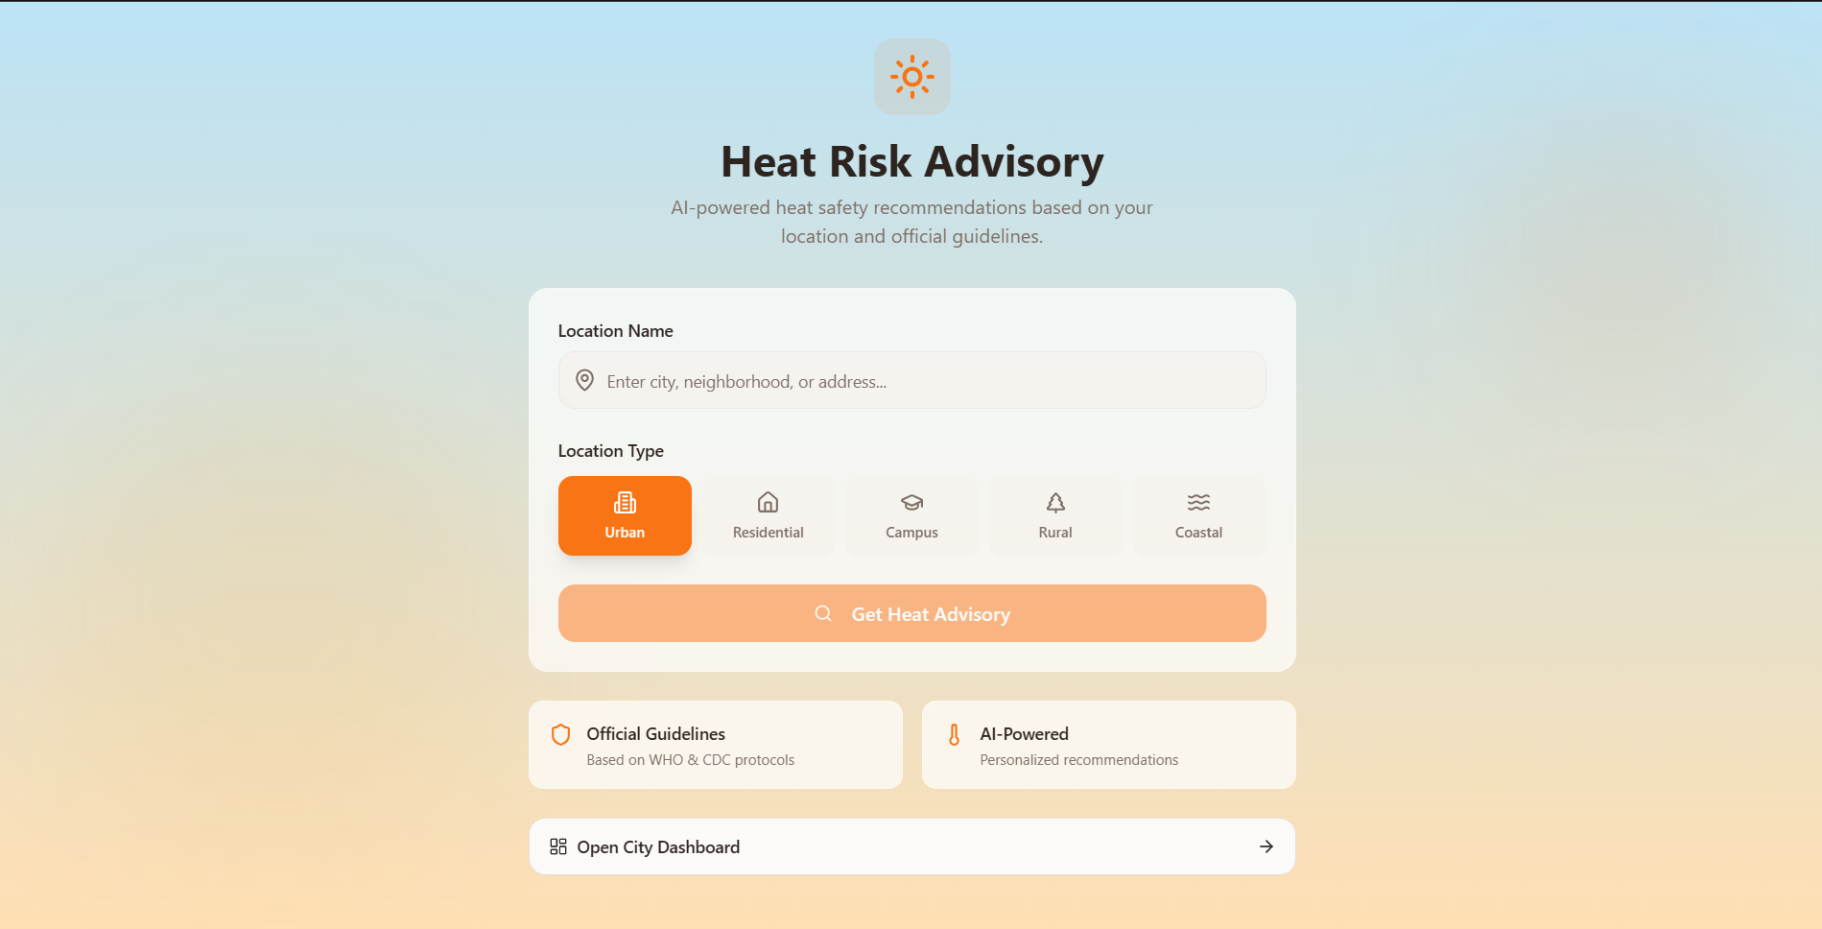

Slide 11
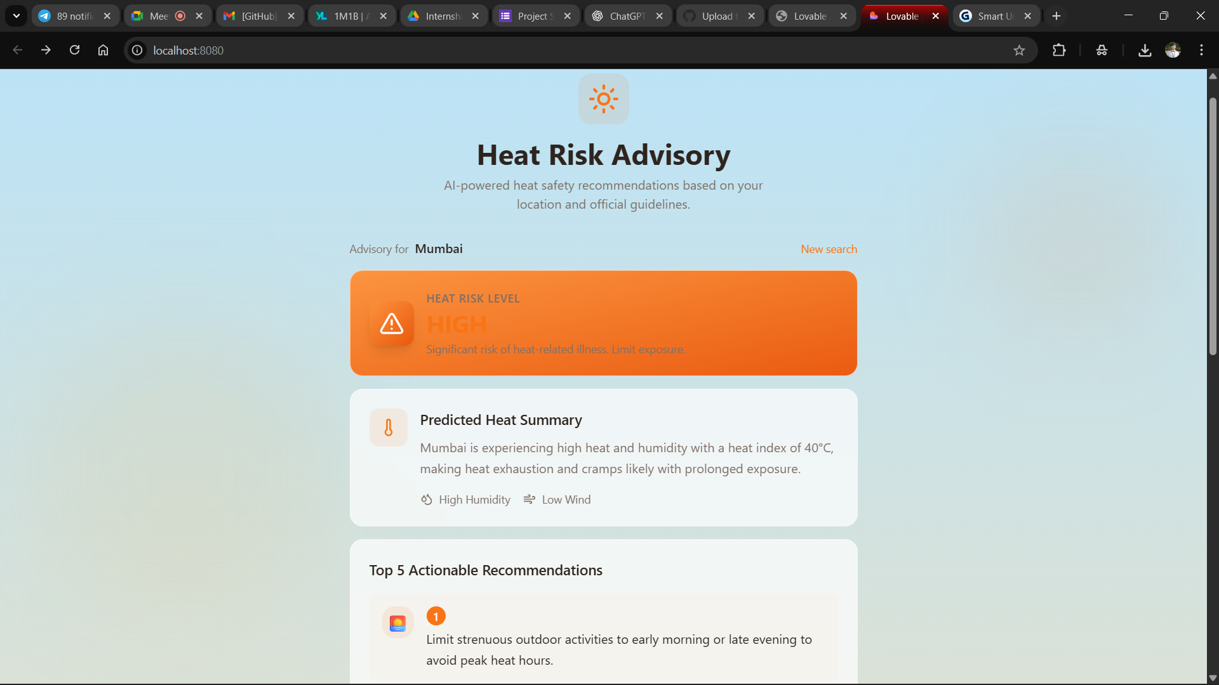

Slide 12
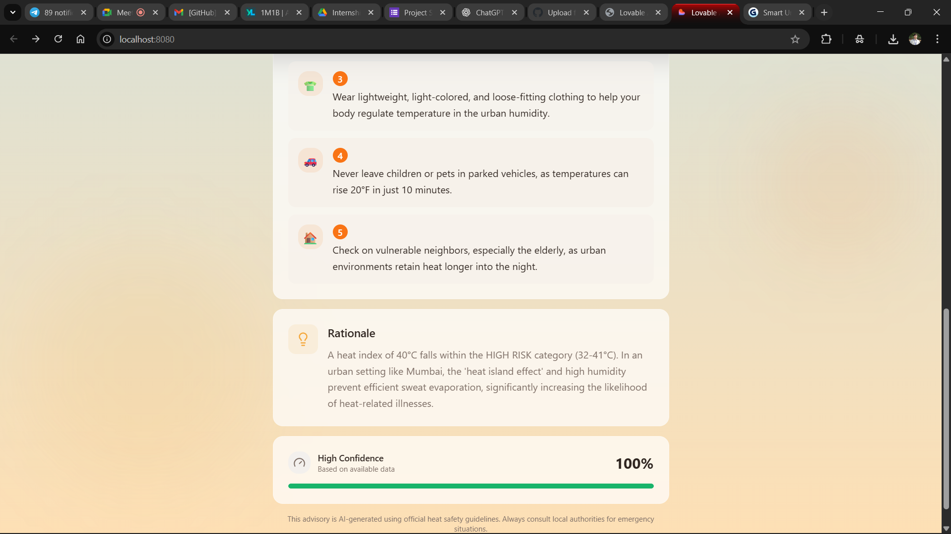

Slide 13


Conclusion & Future Scope
Project Summary
Future Enhancements
The SUHI-MAS project successfully demonstrates the potential of AI to monitor, predict, and mitigate the impacts of urban heat islands, fostering climate-resilient communities.
IoT Sensor Integration: Deploying a network of low-cost IoT sensors for real-time, hyper-local temperature data collection to enhance model accuracy.
This system represents a significant step towards integrating advanced AI technologies into sustainable urban management, offering a scalable solution to a pressing global challenge.
Mobile Application Development: Creating a dedicated mobile app for wider accessibility and personalised heat safety alerts and recommendations.
Advanced Predictive Modelling: Exploring deep learning architectures and reinforcement learning for even more precise UHI forecasting under various climate scenarios.
Policy Integration: Collaborating with urban planners and policymakers to integrate SUHI-MAS insights into official city planning and public health advisories.

